Slide 1



HR
INTELLIGENCE
REPORT
Understanding Employees Exits
Analysis Team
• Dipesh Naik
• Sandhya Bishwal
• Karishma Rathod
• Harsh Yadav

Slide 2
INTRODUCTION
Staff turnover is a Major Challenge for Organizations today. It Increases Hiring costs and Affects Productivity. HR Needs a Clear Way to Analyze employee data and Identify the Root Cause of Attrition. This Dashboard Helps Understand why people leave and where to improve Employee Commitment.
Dataset Overview
Project Workfow
Domain | Human Resources (HR Analytics)
Data Source | Kaggle/Institute Drive
Data Format | Excel File
Tools Used | Power BI Desktop & Power Query
Number of columns | 35
Number of Records | 1470
Raw Data
Data Transformation
Data Visualisation
Dashboard / Report
Insights & Business Recommendations

Slide 3
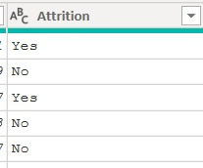
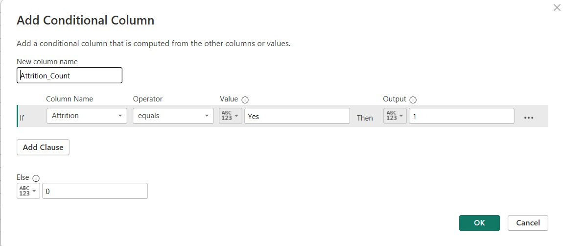
DATA TRANSFORMATION
• Conditional Column Transformation
1) Attrition to Attiriton count
Converted the Attrition column from text values (Yes/No)
into numeric binary format (1/0) to enable calculations and measures.

Slide 4
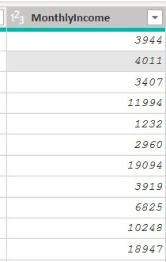
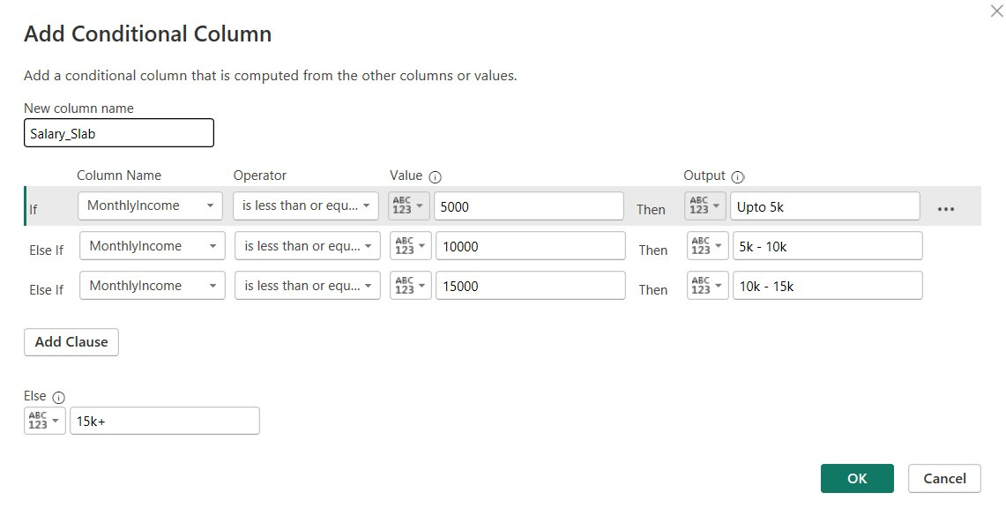
2) Monthly Income to Salary Slab
Created a new conditional column grouping employee salaries into slabs — Upto 5K, 5K-10K, 10K-15K, and 15K+ — for easier trend analysis.

Slide 5
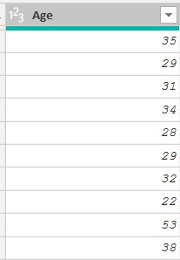
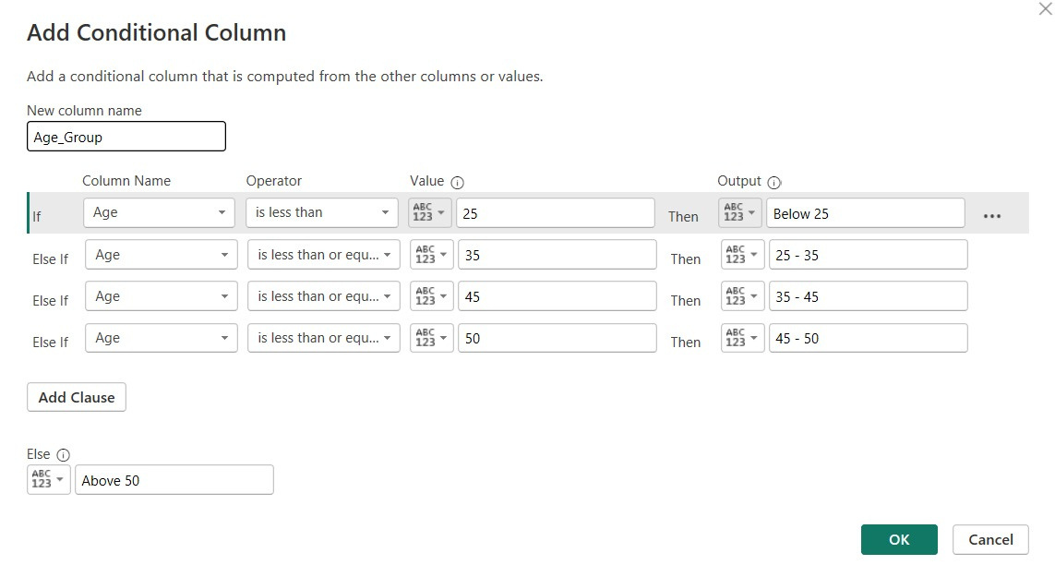
3) Age to Age Group
Created a new conditional column grouping employee age into bands
— Below 25, 25-35, 35-45, 45-50, and Above 50 — to identify attrition patterns by age.

Slide 6
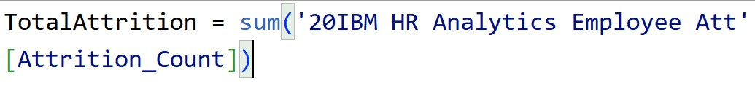
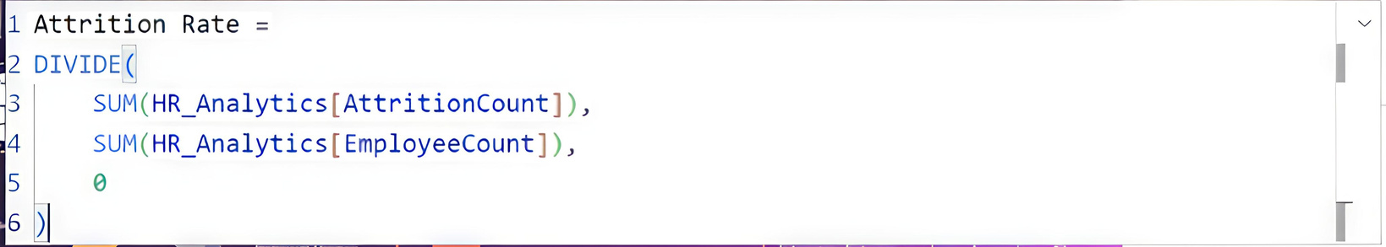
• DAX Measures
Measure 1 : Total Attrition
A DAX measure created to calculate the total number of employees who left the organization.
Measure 2: Attrition Rate (%)
A DAX measure created to calculate attrition as a percentage of the total workforce.

Slide 7
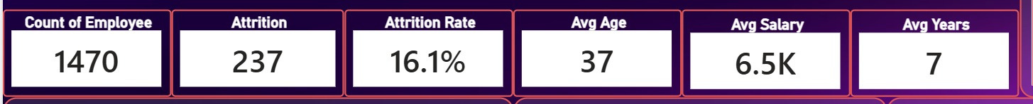
DATA VISUALISATION
Key Performance Indicators (KPI) Overview
The organization has 1470 employees with 237 attritions,
giving a 16.1% attrition rate; average age is 37, average salary is 6.5K
and employees typically stay for 7 years.

Slide 8
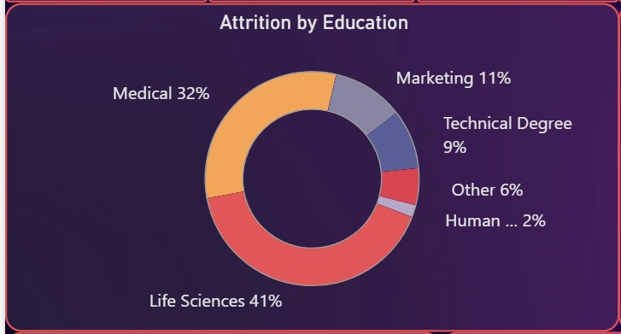
Attrition by Education Field
Life Sciences (41%) and Medical (32%) backgrounds together account
for nearly three-fourths of all attrition, far higher than Marketing,
Technical Degree, Other, or HR.

Slide 9
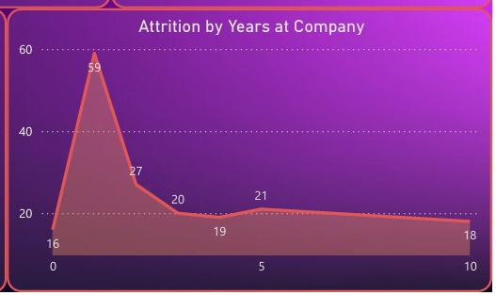
Attrition by Years at Company
Attrition spikes sharply in year 1 (59 exits) — nearly triple any other year —
then steadily declines, showing that most employee exits happen early in their tenure.

Slide 10
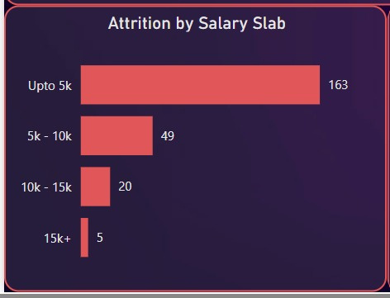
Attrition by Salary Slab
Attrition is heavily concentrated in the lowest salary bracket (Upto 5K), with numbers dropping sharply as salary increases — suggesting compensation is a major driver of exits.

Slide 11
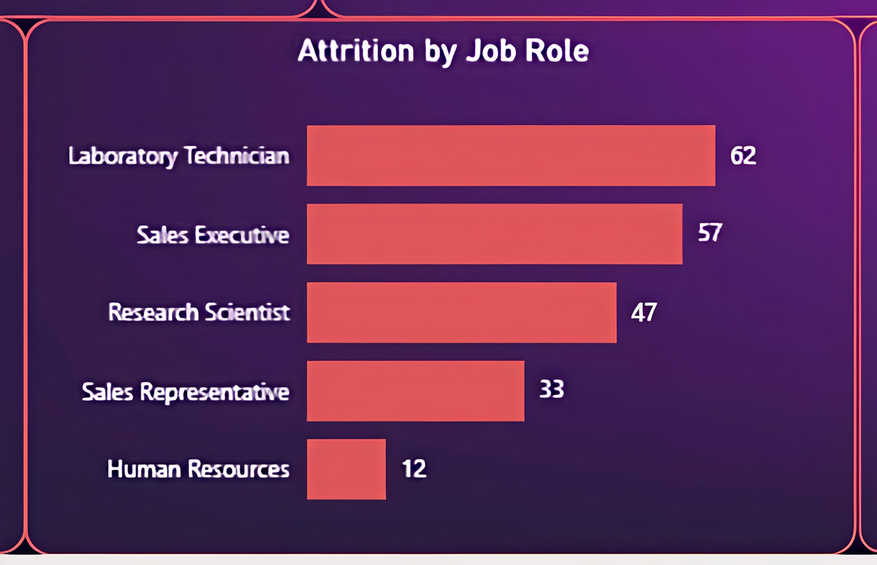
Attrition by Job Role
Laboratory Technician (62) and Sales Executive (57) have the highest attrition counts, together accounting for nearly half of all exits across the top five roles shown.

Slide 12

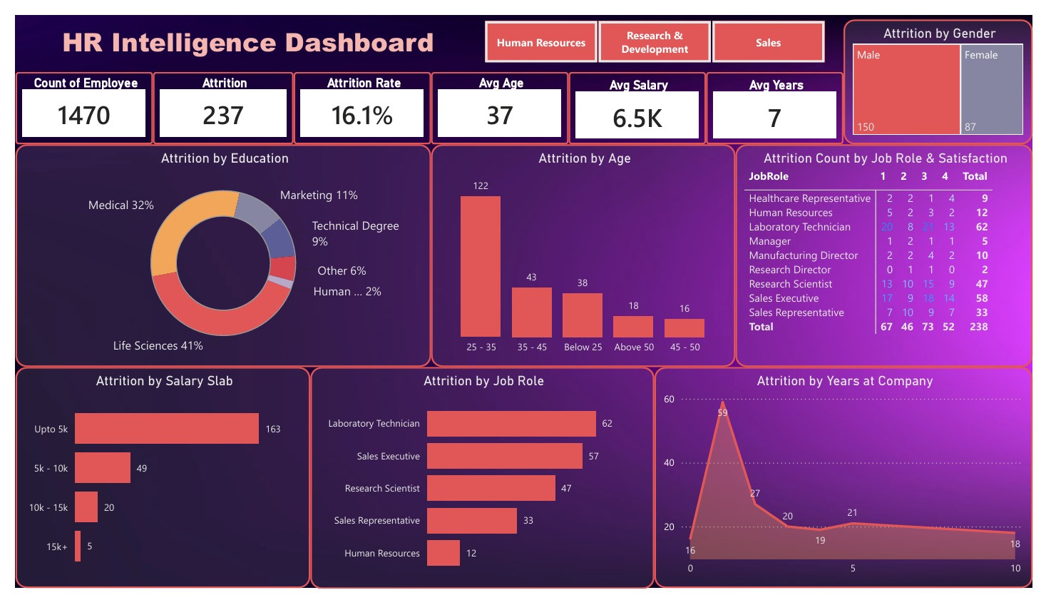
DASHBOARD OVERVIEW
This dashboard shows employee attrition trends across our organization.
It highlights key patterns in age, salary, job roles, and tenure.
These insights help us understand why employees leave and where to improve retention.

Slide 13
KEY INSIGHTS
1. Most Attrition Happens in the First Year
Nearly 1 in 4 employees who leave do so within their first year at the company.
This is far higher than any other year, showing a clear early exit pattern right after joining.
2. Low Salary Is a Major Reason for Leaving
Most attrition comes from the lowest salary group — nearly 70% of all exits are employees earning in the lowest pay bracket. Attrition drops sharply as salary goes up.
3. Young Employees Leave the Most
Employees aged 25-35 make up more than half of all attrition.
This age group is likely looking for faster growth, better pay, or new opportunities elsewhere.
4. Certain Job Roles Are at Higher Risk
Lab Technician and Sales Executive have the highest number of exits. These roles also show lower satisfaction scores, meaning people in these jobs are genuinely unhappy, not just moving on naturally.

Slide 14
5. Job Satisfaction Alone Doesn't Explain Everything
Even 52 employees who rated their satisfaction as high still left the company.
This shows that pay, growth, or outside offers matter just as much as day-to-day happiness at work.
6. Life Sciences and Medical Employees Are the Biggest Risk
Group these two education backgrounds make up 73% of all attrition. Since they likely form the largest part of the workforce, losing them means losing valuable skills and knowledge.
7. Leadership Roles Are Stable
Junior Roles Are Not Senior roles like Research Director, Manager, and Healthcare Representative show very low attrition. This proves the real problem is limited to certain junior roles and early career stages — not the whole company.

Slide 15

BUSINESS RECOMMENDATIONS
Strengthen Onboarding Process
Introduce 30/60/90-day check-ins and mentors for new hires to reduce the sharp attrition seen in the first year.
2. Improve Entry-Level Pay Benchmark
salaries in the lowest pay band against market rates, since low pay is the biggest driver of attrition.
3. Build Career Growth Plans
Offer clear promotion timelines and regular growth conversations for young, entry-level employees to keep them motivated and engaged.
4. Protect Key Talent Pool
Create specialized engagement and development programs for Life Sciences and Medical staff, as they make up the largest share of attrition.

Slide 16

THANK YOU FOR
YOUR ATTENTION
We welcome your questions and
further discussion
IBM HR Analytics Team

